Slide 1
Talker
Simple network communicator

Slide 2
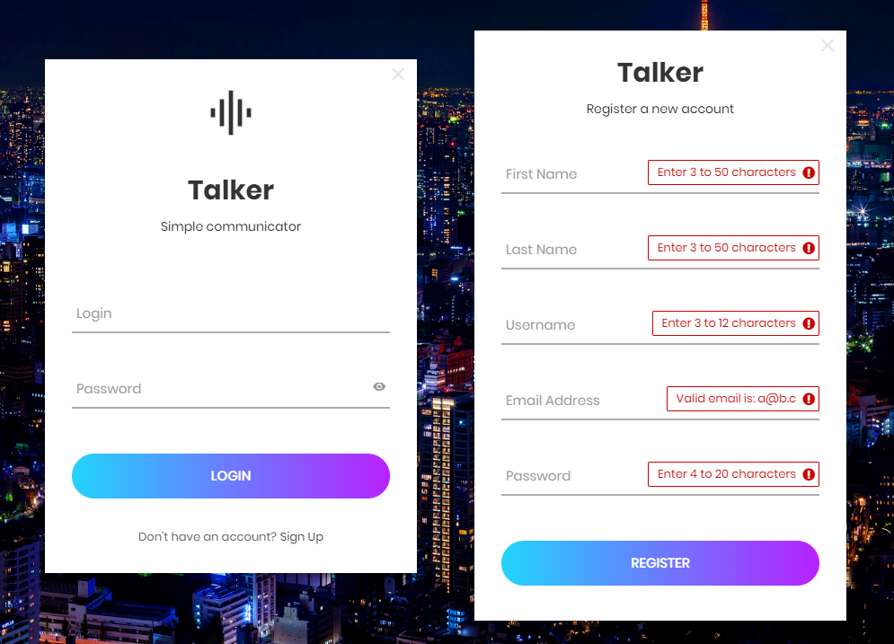

Slide 3
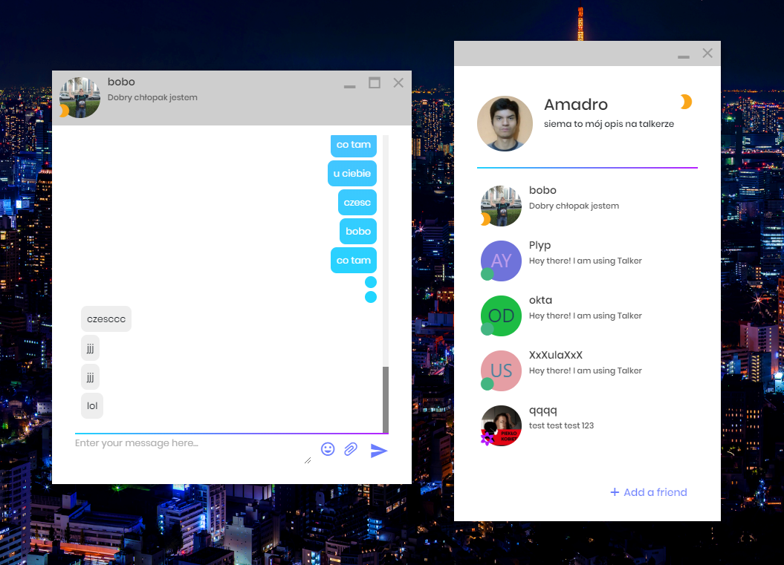

Slide 4
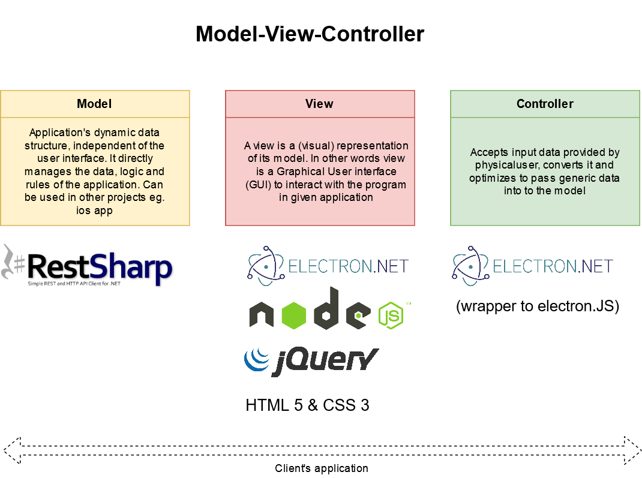
Client's application architecture
More information: https://dotnet.microsoft.com/apps/aspnet/mvc, https://www.electronjs.org and https://jquery.com

Slide 5
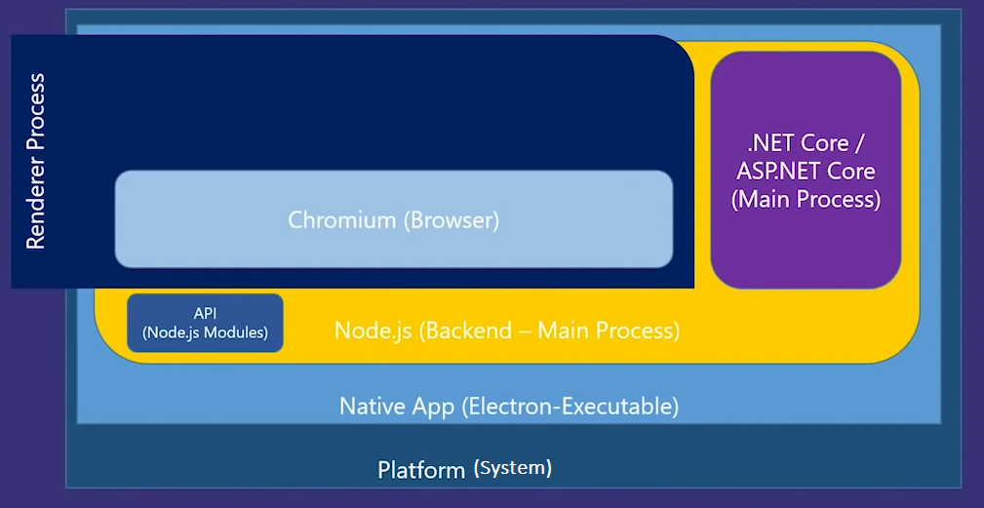
Electron.NET and Electron.CLI architecture
More information:
https://github.com/ElectronNET/Electron.NET https://www.nuget.org/packages/ElectronNET.API
https://www.nuget.org/packages/ElectronNET.CLI

Slide 6
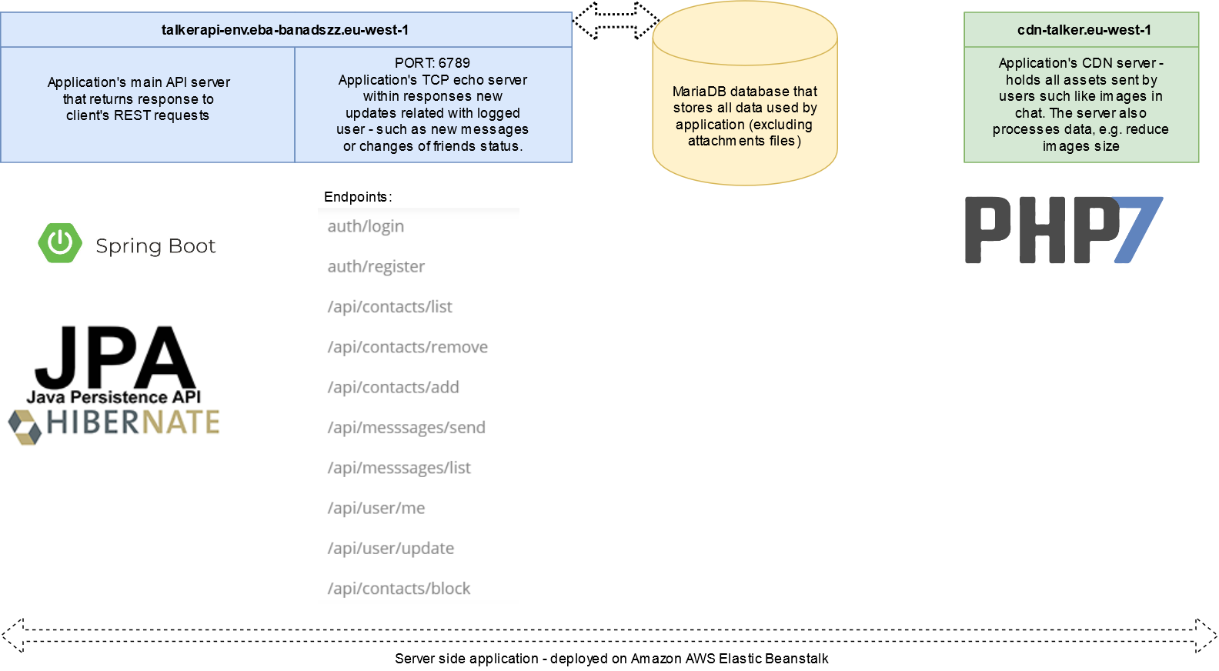


Server-side application architecture
REST Api
Heartbeat TCP server
Content Delivery Network
More information: https://spring.io, https://spring.io/projects/spring-boot, https://www.geeksforgeeks.org/rest-api-introduction and https://aws.amazon.com

Slide 7
Presentation of some application possibilities
> User sends a message with an attachment to another user
> User receives a message with an attachment

Slide 8
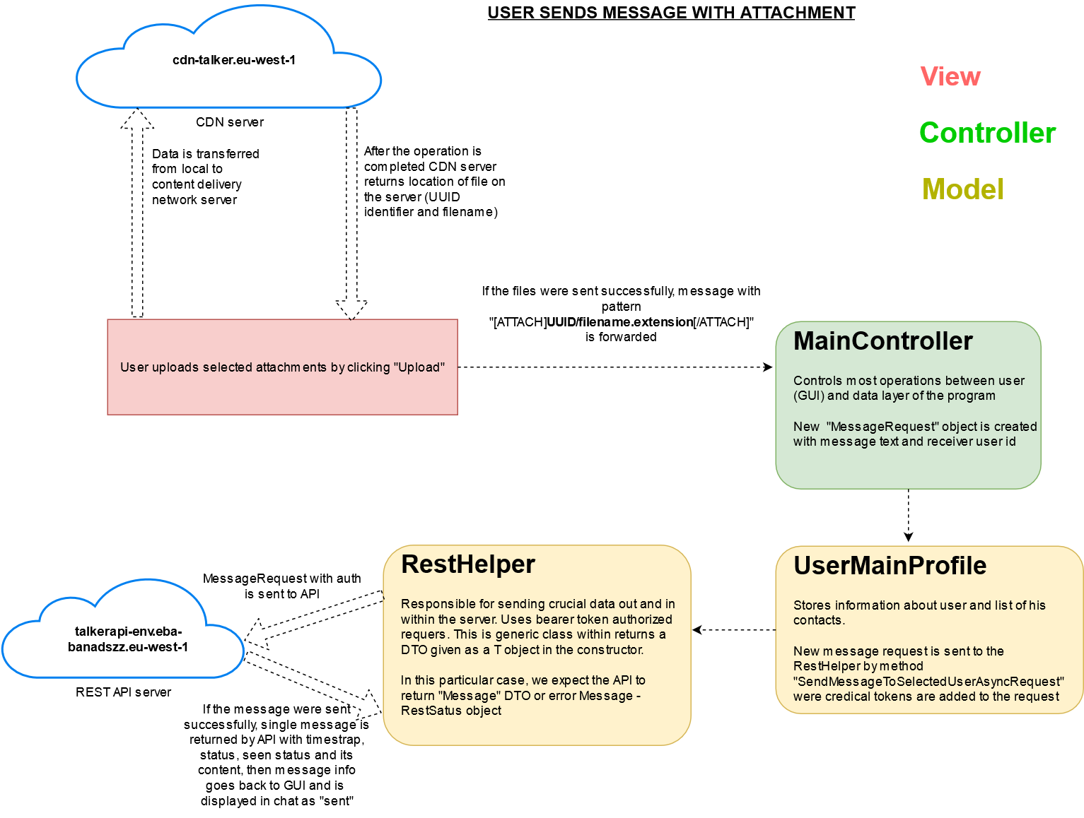
User sends a message with an attachment to another user

Slide 9
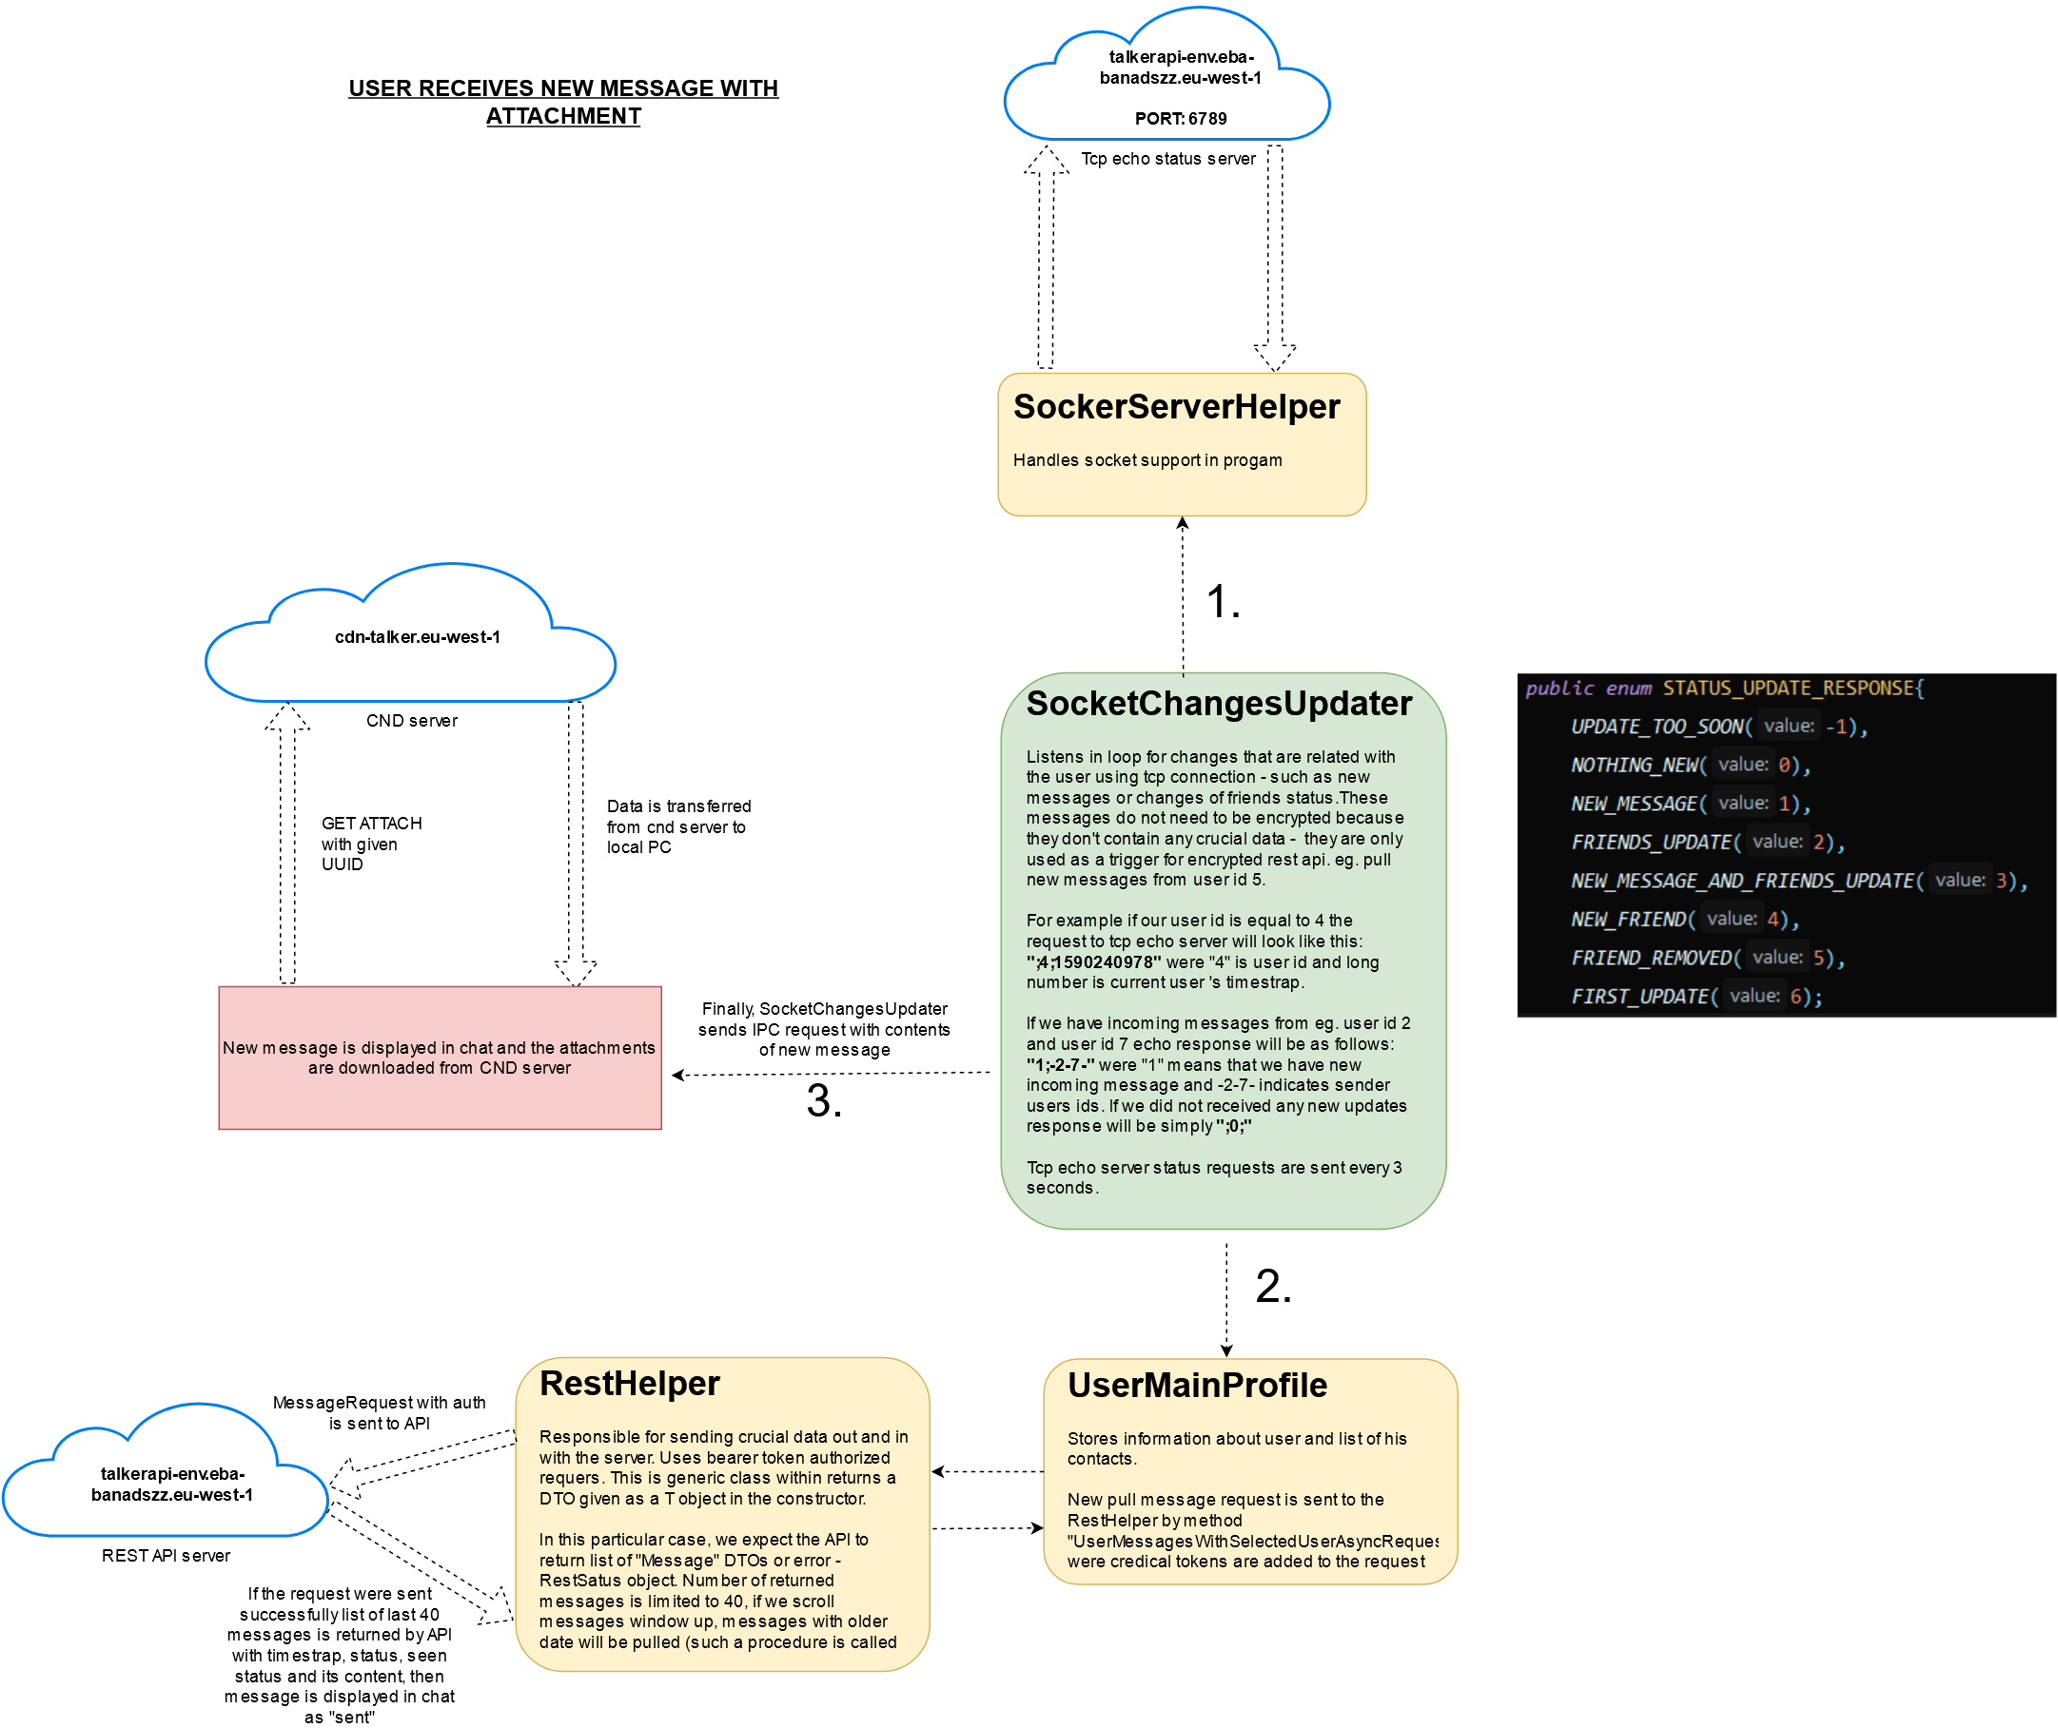
User receives a message with an attachment

Slide 10
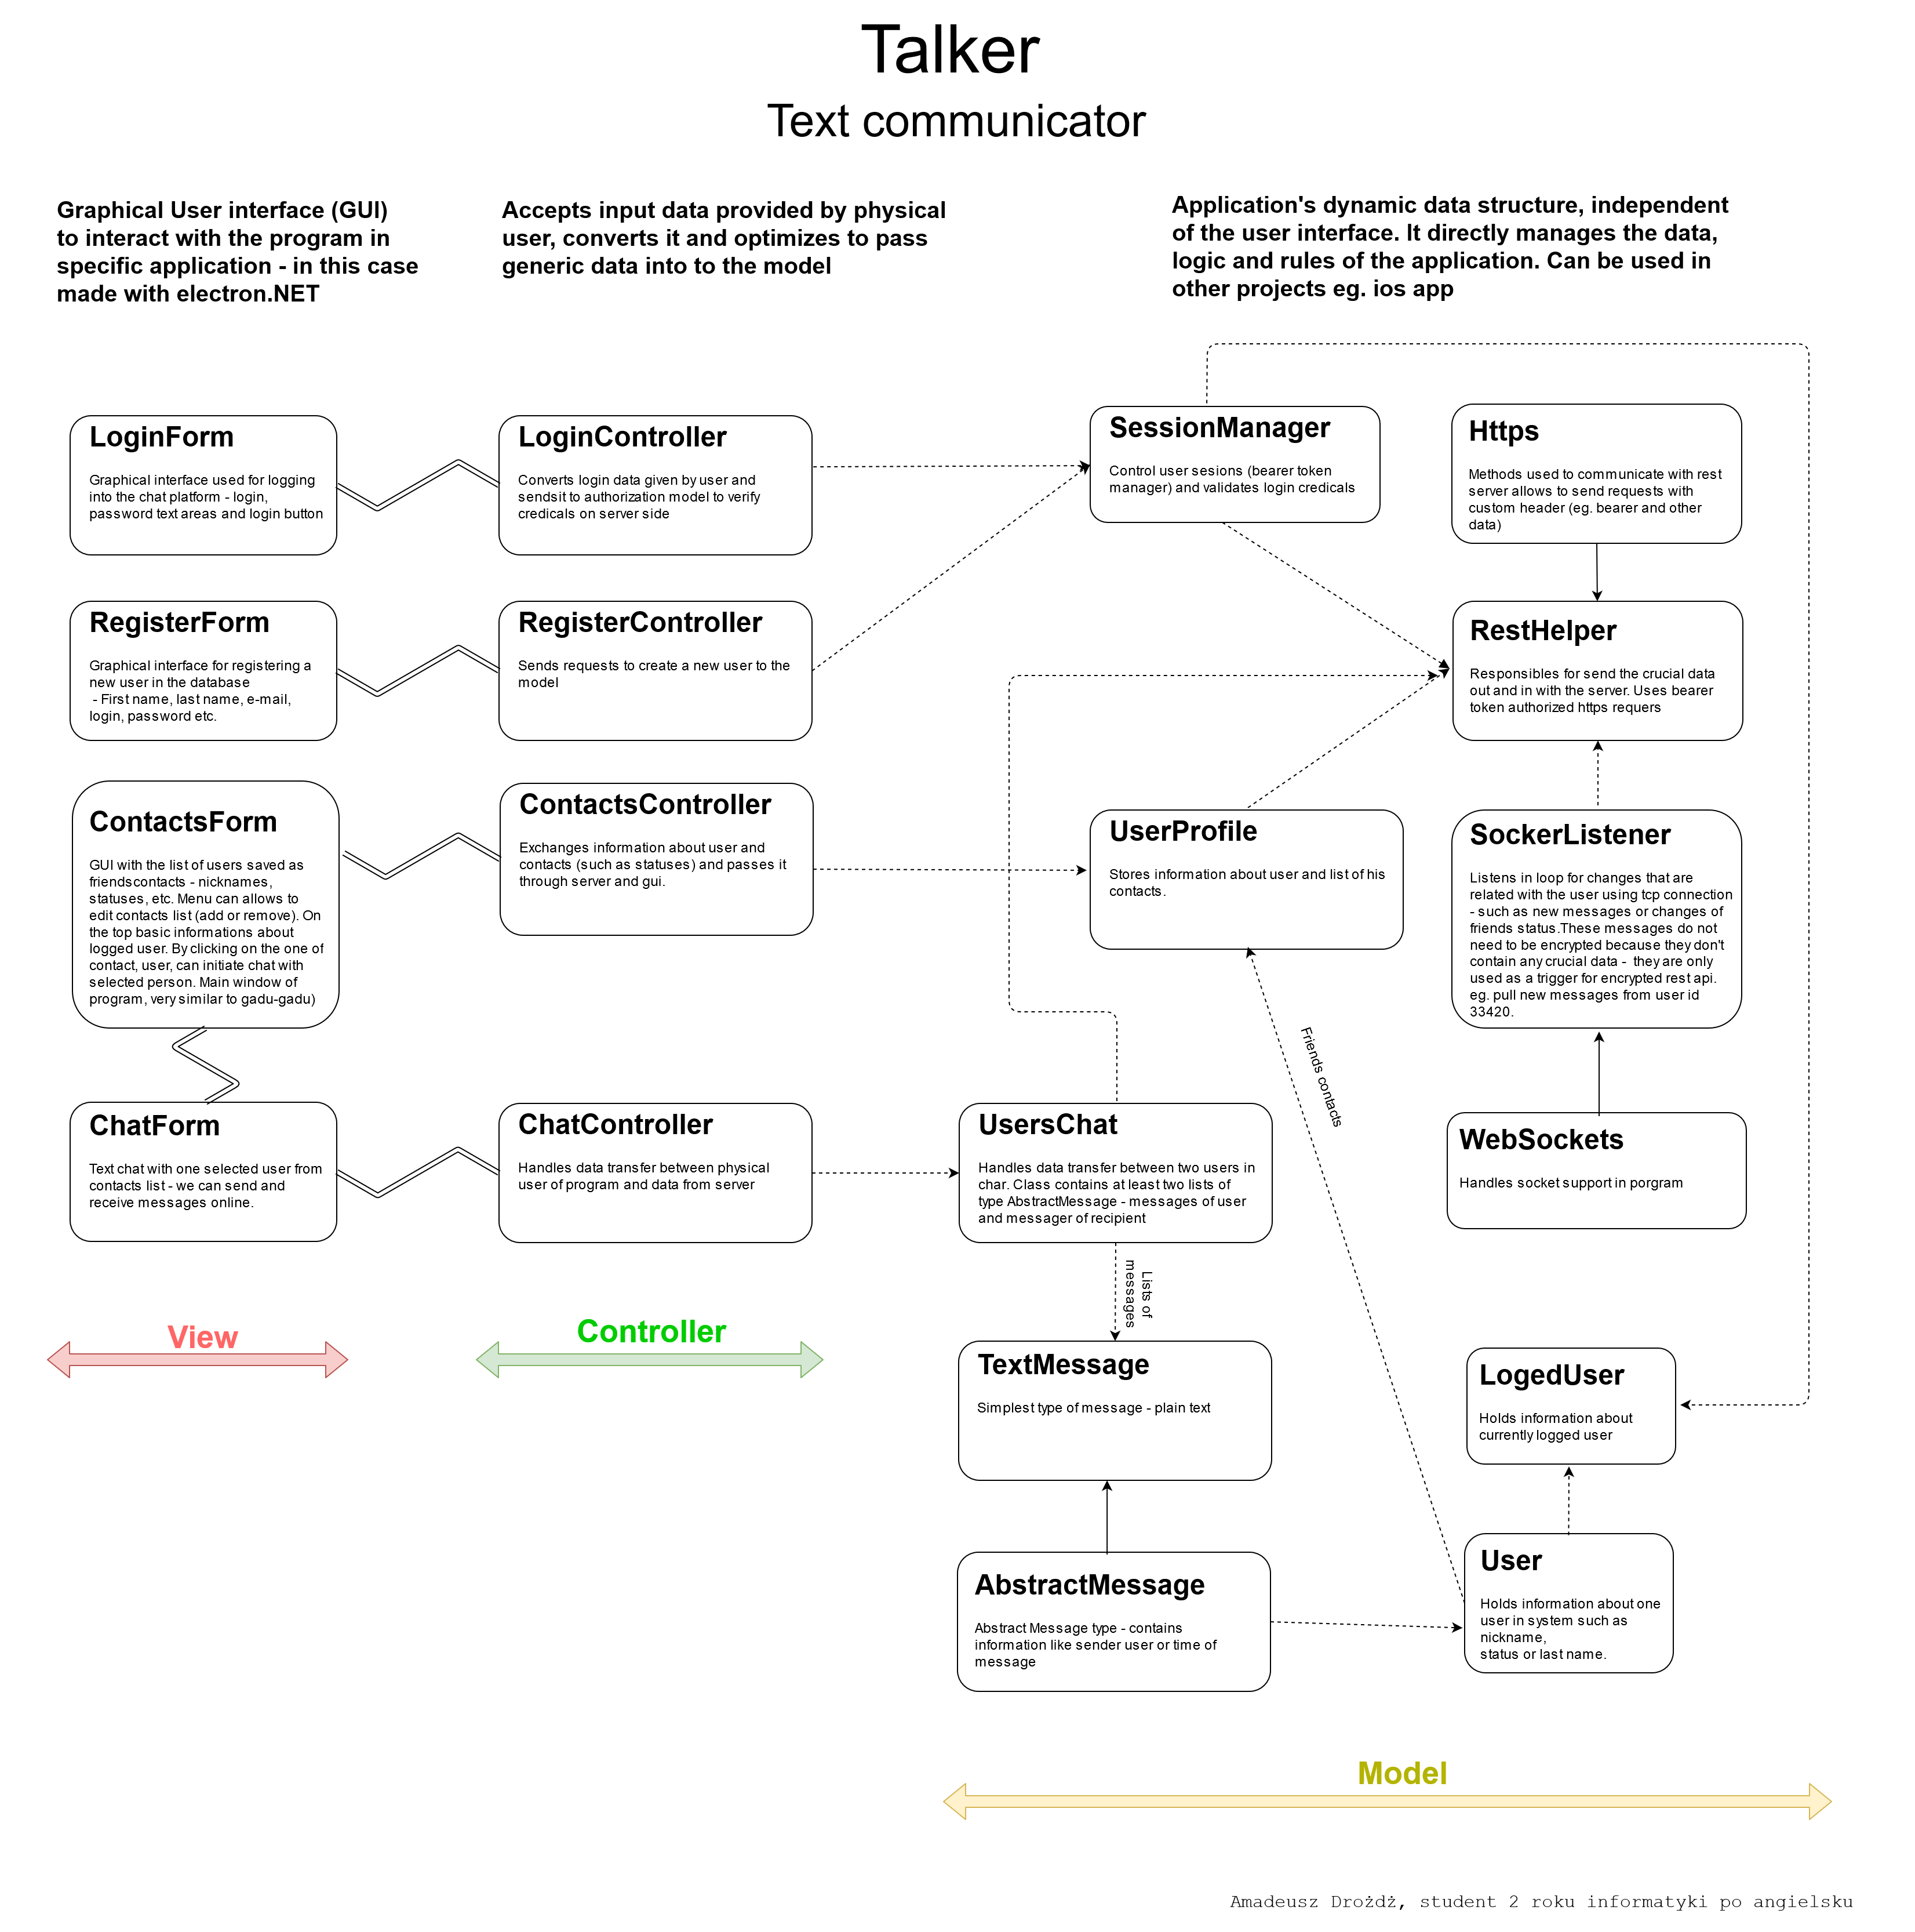
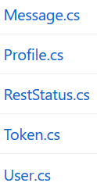

Full diagram – client’s app
DTOs:
The diagram: Dotted lines -> marks references to class objects or static classes; Continuous line -> inheritance
Double lines -> marks the IPC communication between JS and C#.
More information:
wikipedia.org/wiki/Data_transfer_object

Slide 11
Thank you for your attention

